Slide 1
Does advertising increase sales!??
Marketing strategy of MAGGI
GO!

Slide 2
Contents of This Template
Here’s what you’ll find in this ppt::
Is TV still the most Effective ad medium?Maggi marketing strategy before controversy.
The Maggi Noodles crisis in 2015 and the loss they faced.
How advertising helps them during crisis?
Few sample posters they used to attract and connect public.
Hypothesis Test to prove advertising increases sales.:
By comparing 2min maggi pocket(advertising more) and Atta noodles(advertising less).
Conclusion.

Slide 3
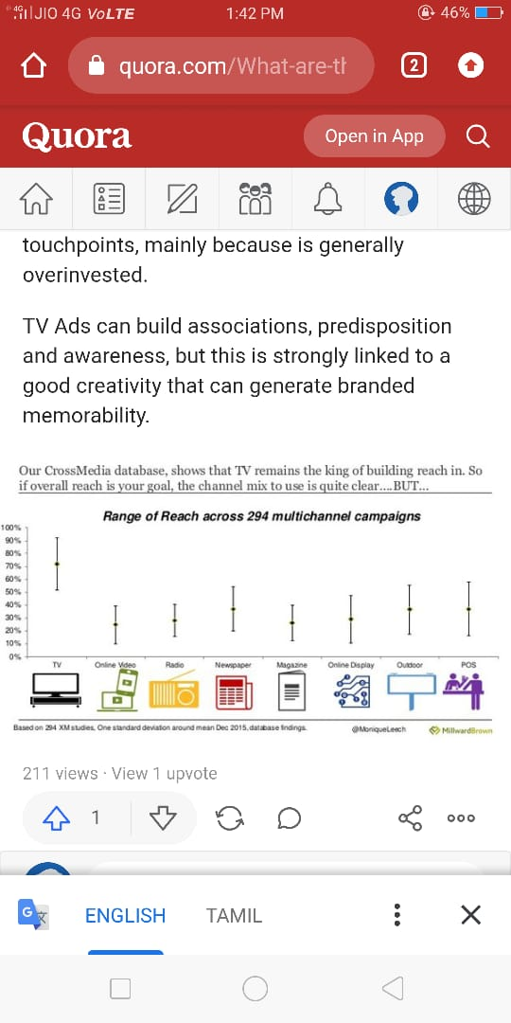
“Tv Ad has unbeatable scale and reach”
—Someone Famous

Slide 4


MAGGI
01
02
03
Maggi is an international brand of noodles.
The brand was acquired by Nestle in 1947.

Slide 5
TARGETING
Working women
Mothers
KIDS:
Credits
MAGGI targeted kids.
They were the ones who were ready to accept tasty foods.
There was not much competition around.
It clicked.
Emotionalconnect:Children,their hunger and happiness. And also as reward for kids.
Housewives could be creative and add her own recipe.
As housewives moved to offices,they earned more money but had lesser time.
So,the idea of instant food was spreading.

Slide 6
TARGETING
Working women
Kids & teenagers
Old people who find it difficult to cook
People on the move

Slide 7
Slogans they used to reach their targets
Fast to cook..Good to eat
Your food. Your style
Taste bhi health bhi
2 – minute noodles

Slide 8
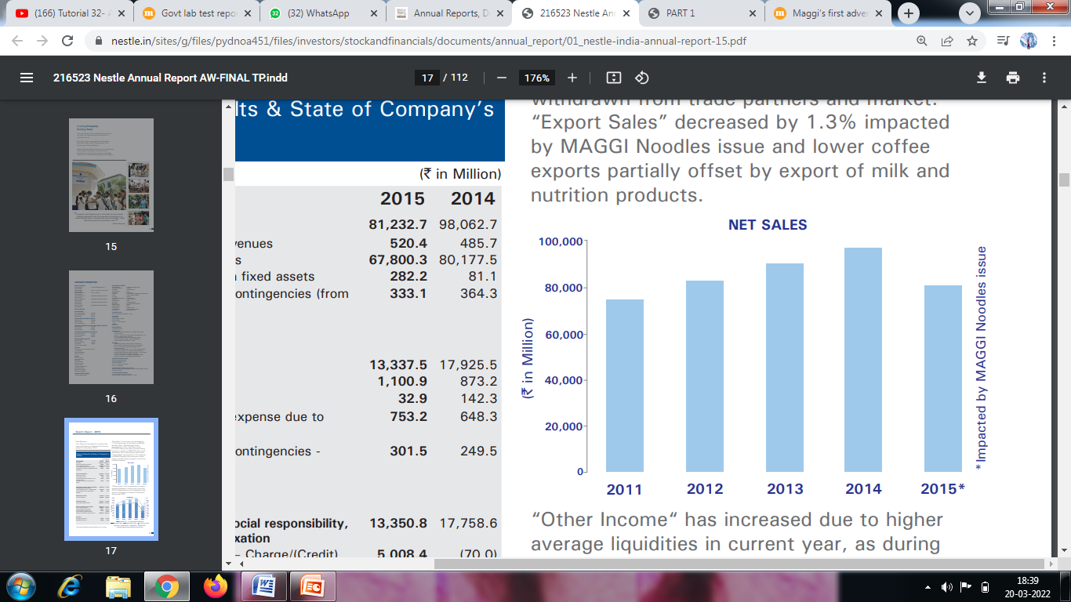

Maggi Banned
Maggi ,which has been dominating the instant noodles market in india,was banned in 2015.
Net Sales” for the year has decreased by 17.2% largely
due to the impact of MAGGI Noodles issue

Slide 9
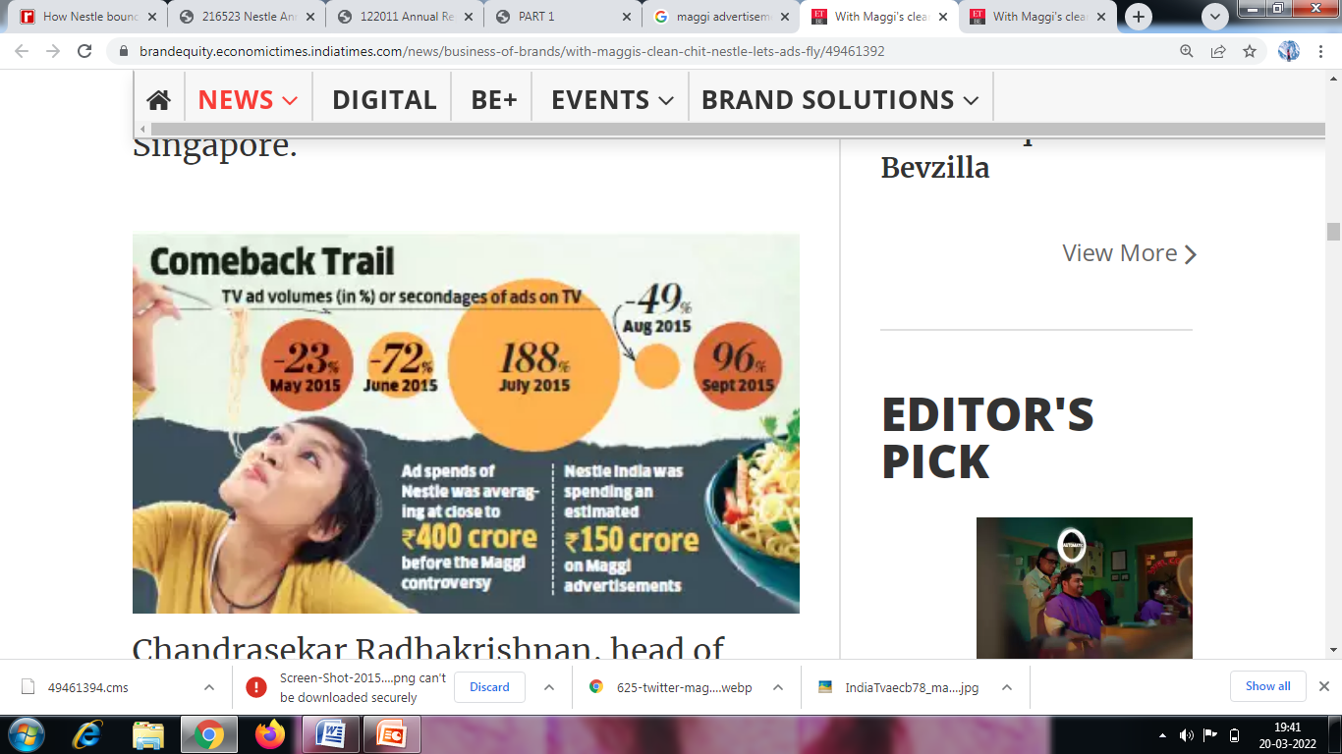
Strategy: Maggi after controversy
“Your Maggi is safe,has always been.”
Still maggi is the leading company in noodles.
How did they comeback???
They invested more(96%) on advertisement.
Keeping in touch through increased ad space.

Slide 10

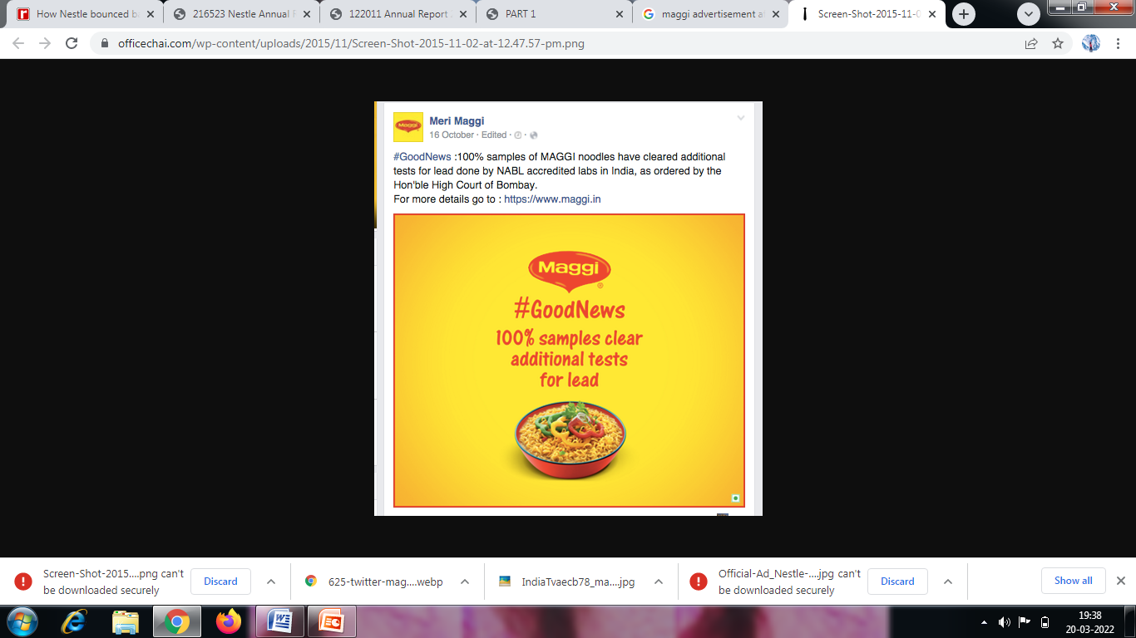
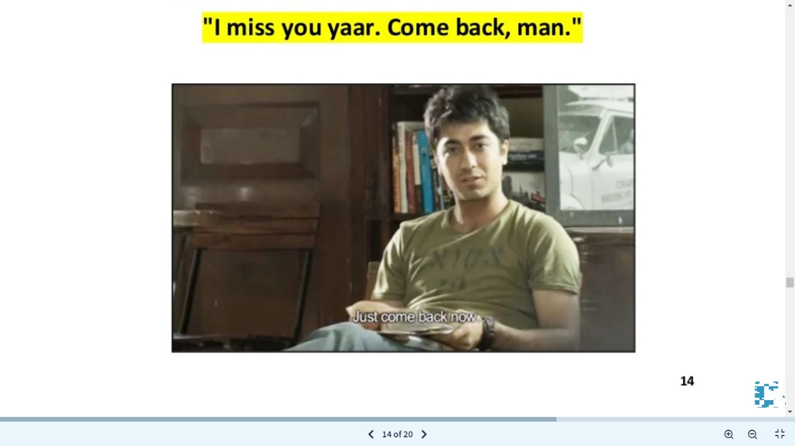
#WeMissYouToo
01
ADS;
02
03

Slide 11

#MAGGI MOTHER
01
#LET YOUR MOM KNOW;
02
03
The first ad after re-launching was of a mother speaking about her child’s tryst with his maggi,thus further adding emotional value of customer’s right there.
This way it impressed mothers.

Slide 12
These steps have helped Maggi become a market leader AGAIN!
They regain the lost trust by strengthening the connection with public by investing more on ads.
They conveyed the message.Bold moves put up by maggi did help to regain people’s confidence to extent.

Slide 13
Hypothesis test

Slide 14
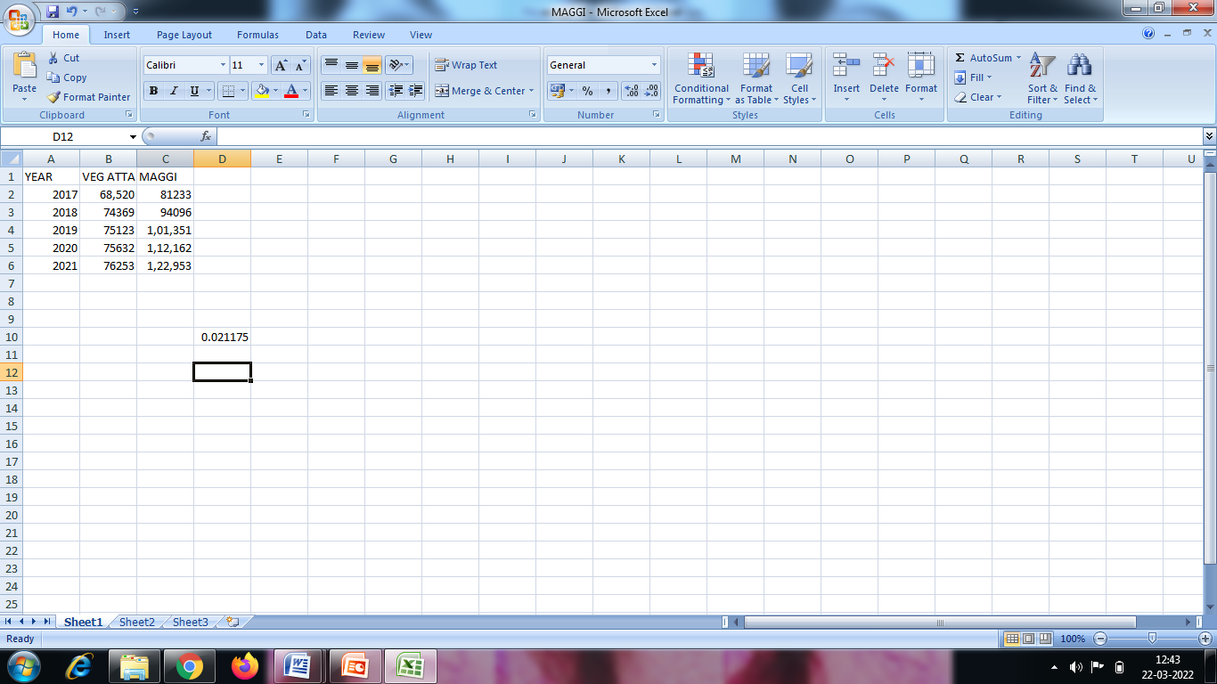
Hypothesis test
To find wheather ad increases sales statistically ,we here perform hypothesis test.
Step 1:Y – sales
X- advertising
Step 2: confidence level ; 95%, alpha =0.05
Step 3: According to the data, we select the test needed to be performed.
Step 4: H0= null hypothesis
H1 : alternate hypothesis
Step 5 : The test is performed
Step 6 :the value of p is found to be 0.02
IF P VALUE IS HIGHER THAN ALPHA ,NULL IS ACCEPTED.IF PVALUE IS LESS THAN ALPHA WE REJECT THE NULL.
Step 7: P is less than alpha,then there is a difference.
Conclusion: Thus,advertising increases sales.

